Slide 1
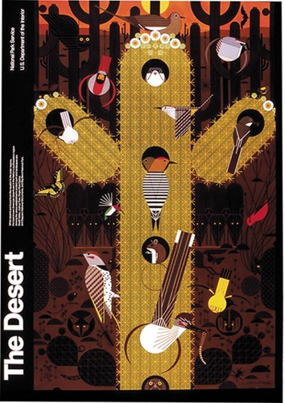
Ecology

Slide 2
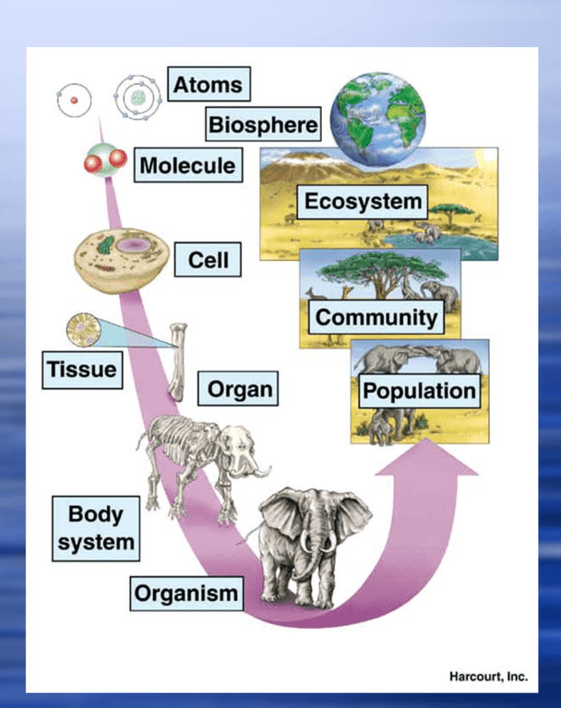
Ecology
Levels of
Organization
Ecology focuses on the dynamics at the population and ecosystem levels

Slide 3
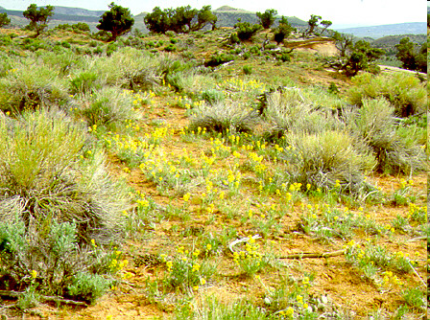
Ecology: Population Dynamics
0
Population ecology is the study of how and why populations change
A population is a group of individuals of a single species that occupy the same general area

Slide 4
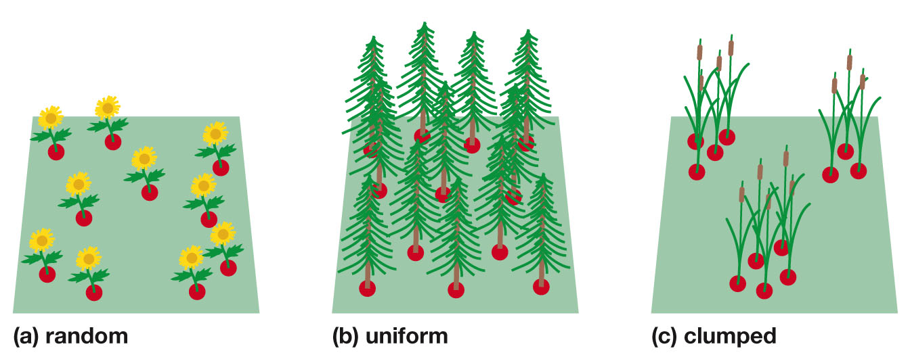
Ecology: Population Dynamics
0
Environmental and social factors influence the spacing of individuals in various dispersion patterns: clumped, uniform, or random

Slide 5
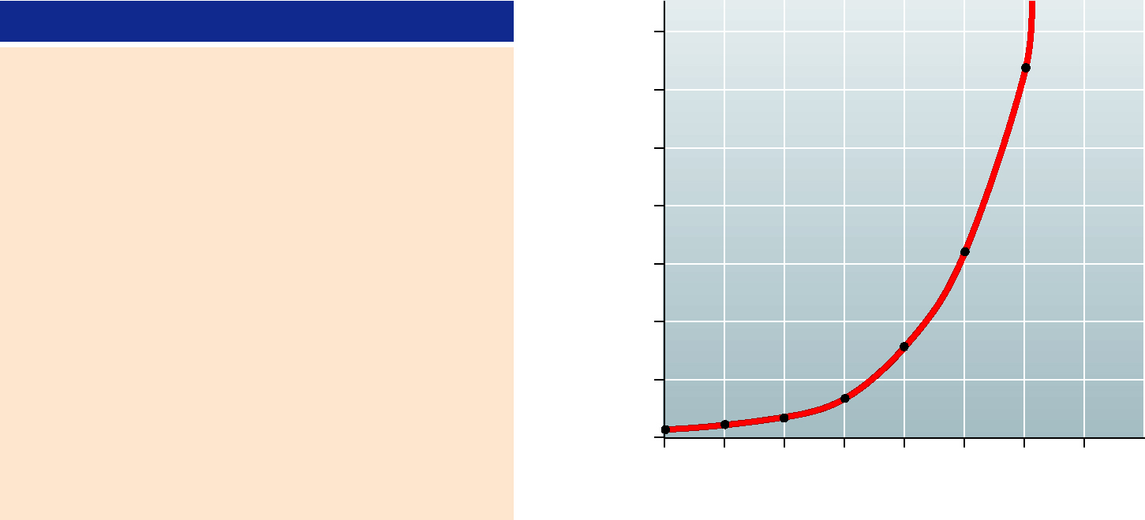
Ecology: Population Dynamics
0
Populations change over time as a combination of the birth rate and the mortality rate.
Exponential growth is the accelerating increase that occurs when growth is unlimited. The equation G = rN describes this J-shaped curve
G = the population growth rate
r = an organism’s inherent capacity to reproduce
N = the population size
Time
Number of Cells
70
0 minutes
1
2
4
8
16
32
64
512
4,096
16,777,216
68,719,476,736
= 2⁰
= 2¹
= 2²
= 2³
= 2⁴
= 2⁵
= 2⁶
= 2⁹
= 2¹²
= 2²⁴
= 2³⁶
60
20
40
60
80
100
120
50
Number of bacterial cells (N)
40
30
(= 2 hours)
20
3 hours
4 hours
8 hours
G = r N
10
12 hours
0
0
20
40
60
80
100
120
140
Time (min)

Slide 6
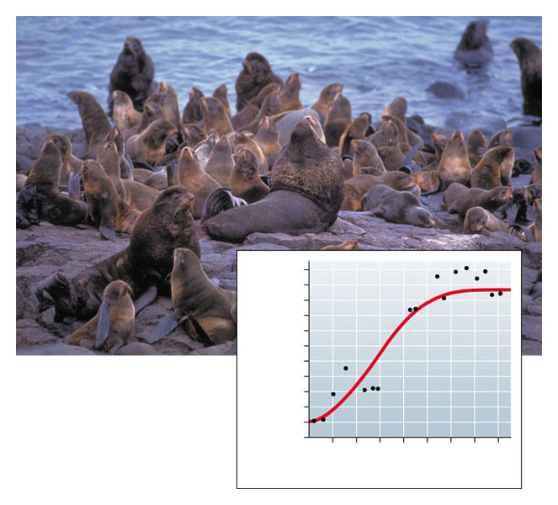
Ecology: Population Dynamics
0
Limiting factors are variables that restrict population growth such as limited space, food, water or the ability of the ecosystem to process waste from a population.
The equation G = rN(K – N)/K describes a logistic growth curve where
K = carrying capacity
Carrying Capacity is the size of the population that can be sustainably supported by the environment.
10
8
Breeding male fur seals
(thousands)
6
4
2
0
1915
1925
1935
1945
Year

Slide 7
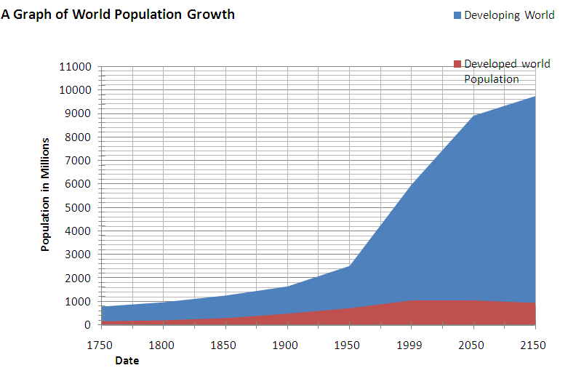
Ecology: Population Dynamics
0
Human Population Growth
Link to Human Population Distribution Map
Link to Current World Population

Slide 8
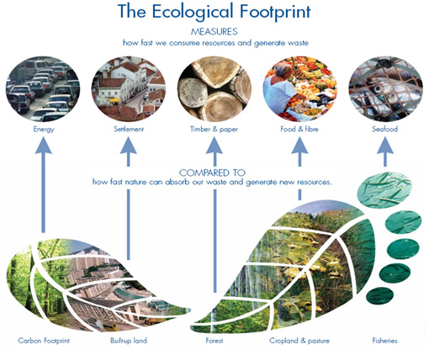
Ecology: Population Dynamics
An ecological footprint is the impact of a person or community on the environment, expressed as the amount of land required to sustain their use of natural resources.

Slide 9
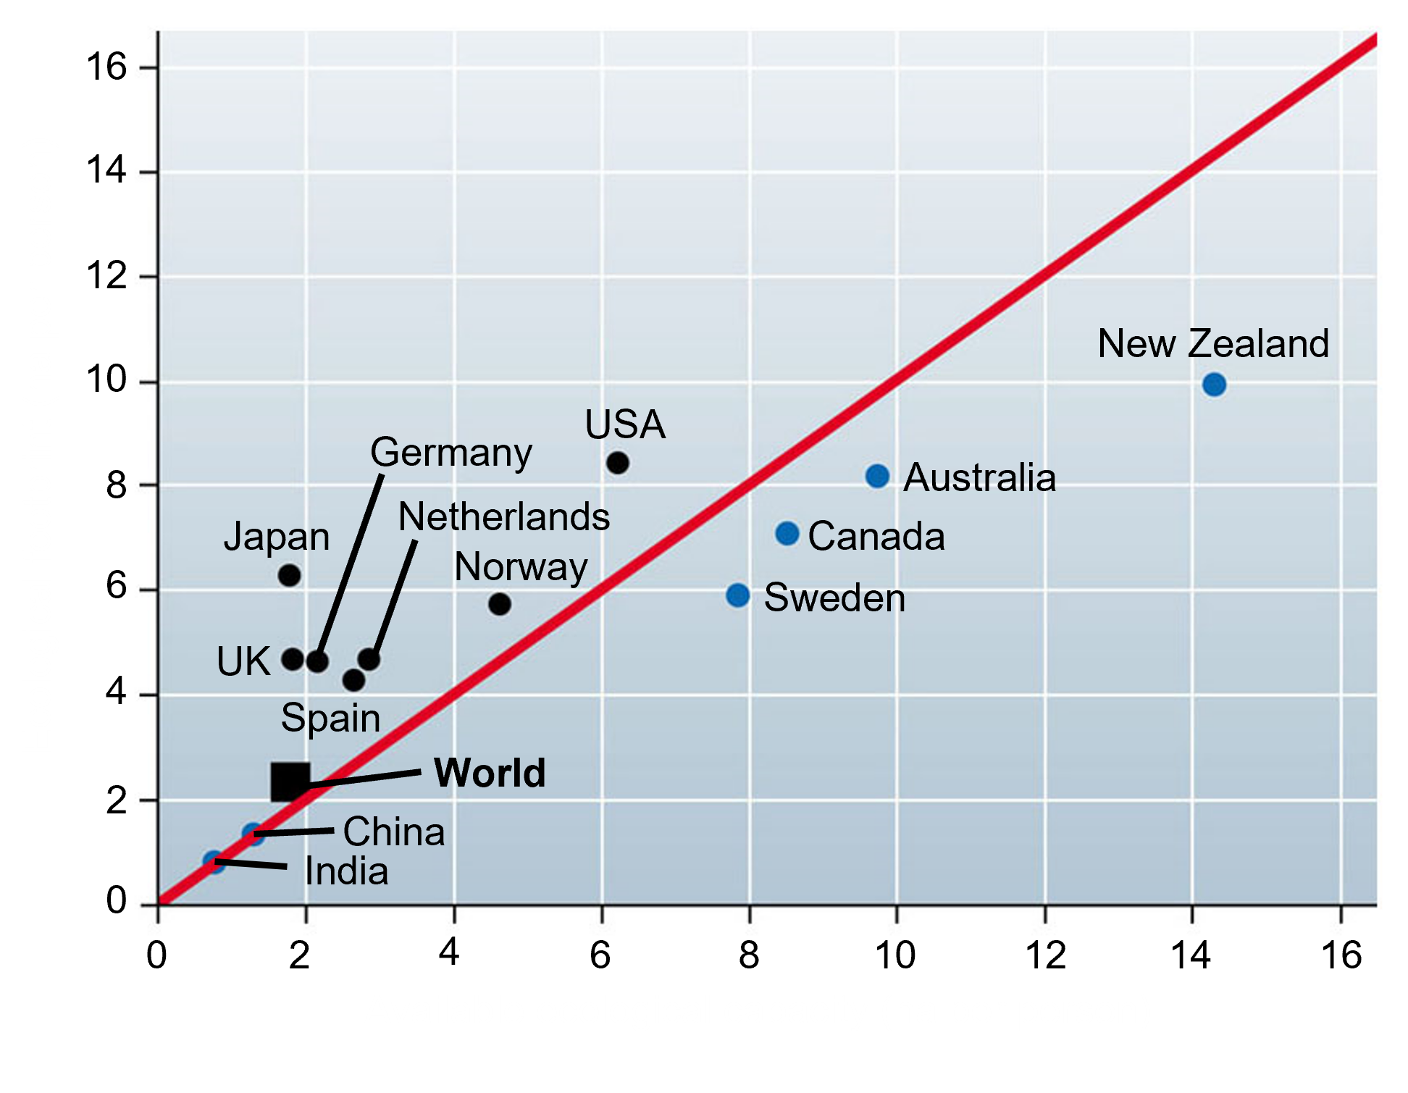
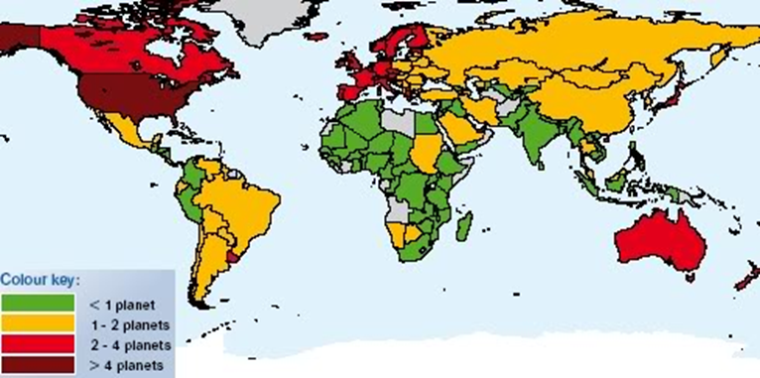
Ecology: Population Dynamics
0
The ecological footprint of a nation differs across the globe.

Slide 10
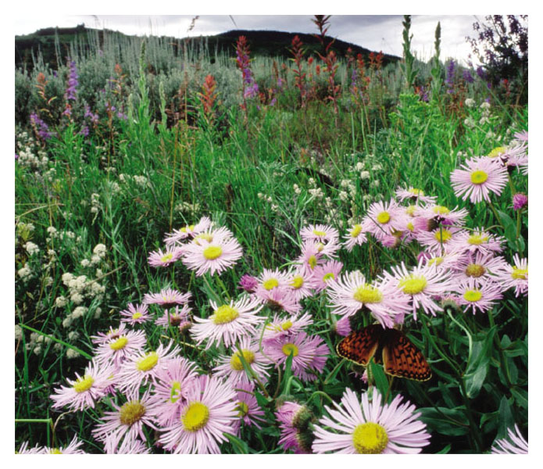
Ecology: Community Dynamics
0
A biological community is an assemblage of all the populations of organisms living close enough together for potential interaction

Slide 11
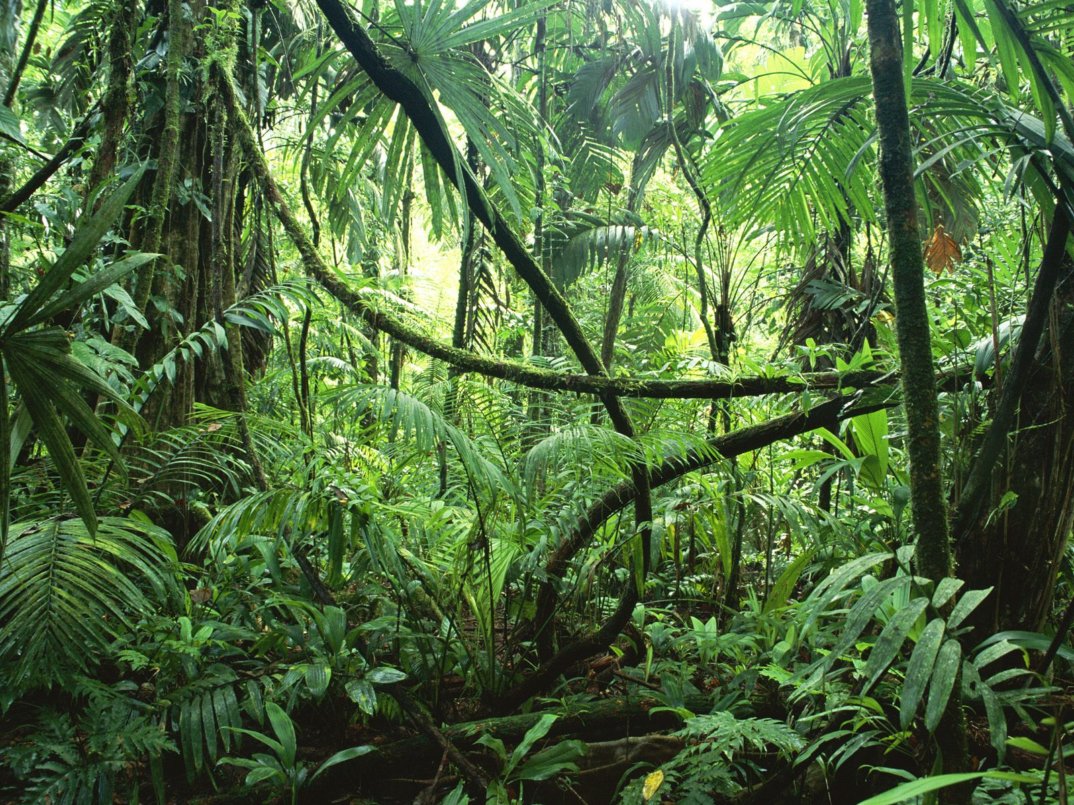
Ecology: Community Dynamics
Competition

Slide 12
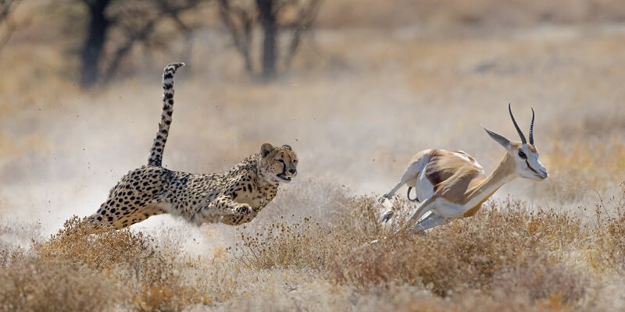
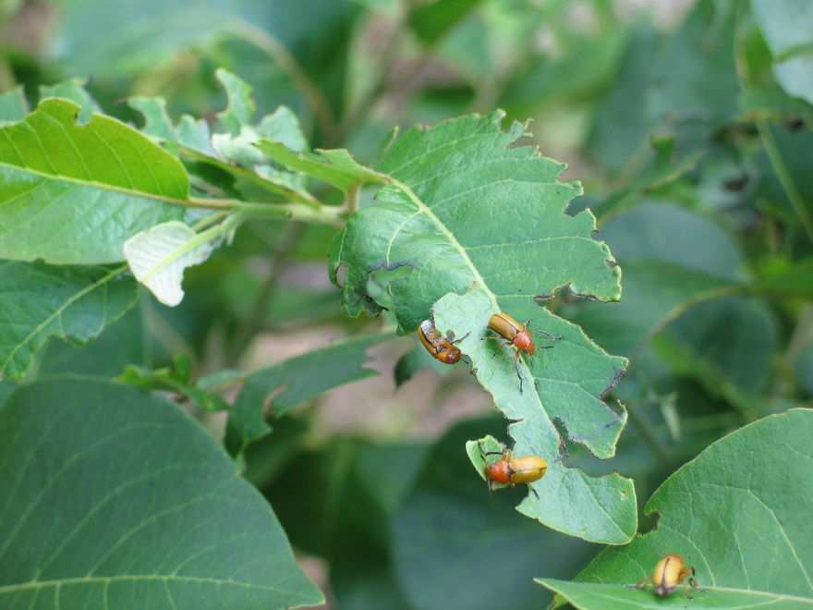
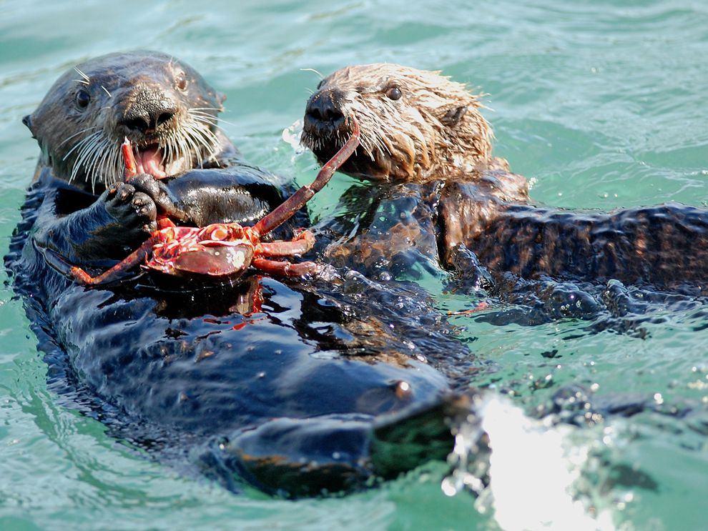
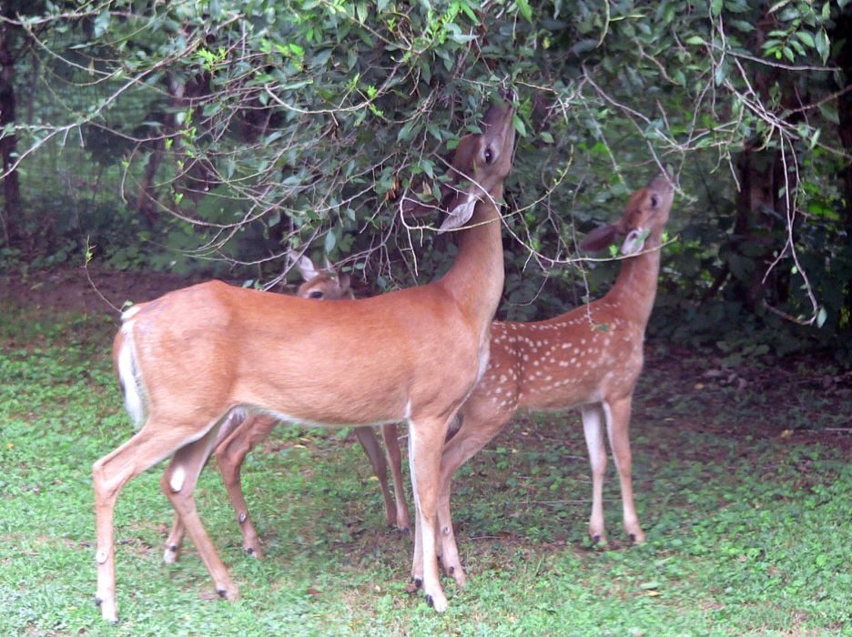
Ecology: Community Dynamics
Predation

Slide 13
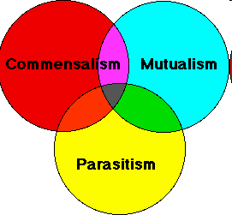
Ecology: Community Dynamics
0
Symbiosis
A symbiotic relationship is an interaction between two or more species that live together in direct contact

Slide 14
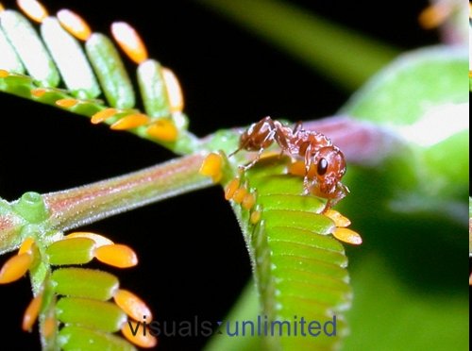
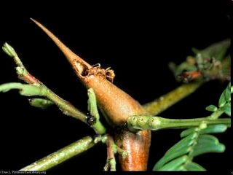
Ecology: Community Dynamics
Symbiosis: mutualism
Association between Acacia and ants:
Ants live in hollow thorns.
Ants feed on sugar, fats and proteins from petiolar nectaries and from special bodies at tips of leaflets.
Ants attack other organisms that come into contact with plant.

Slide 15
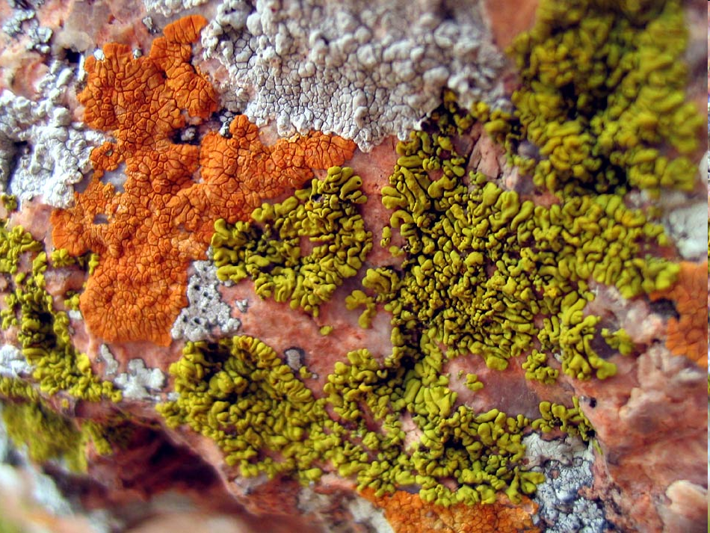
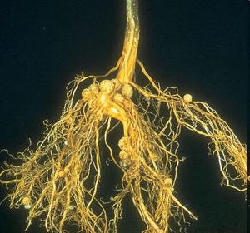
Ecology: Community Dynamics
Symbiosis: mutualism

Slide 16
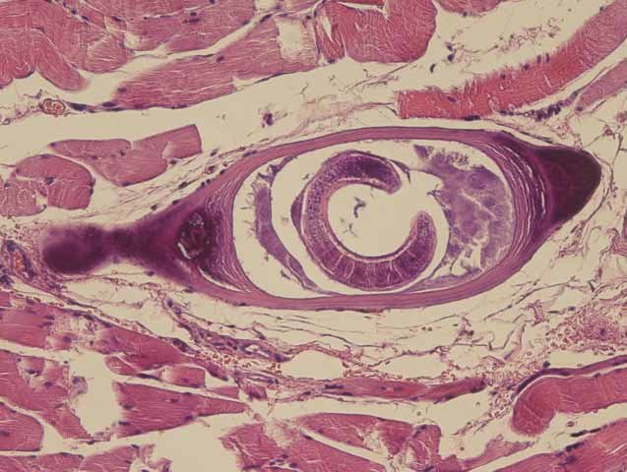
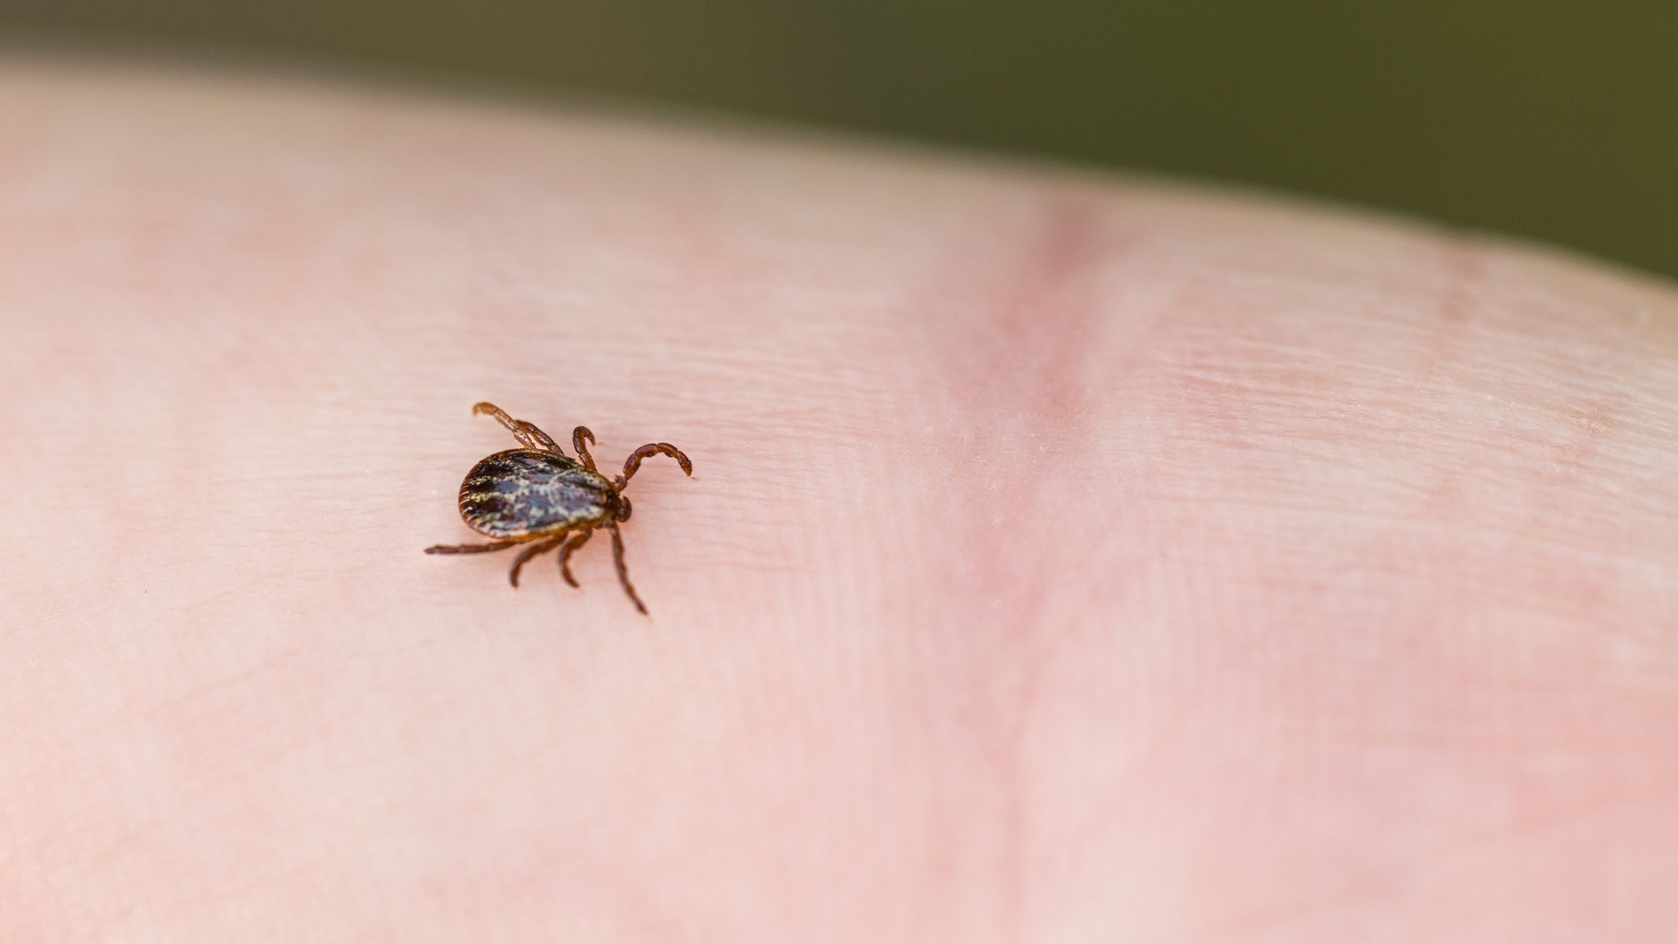
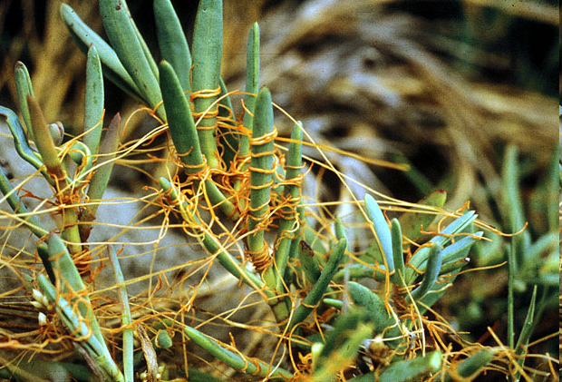
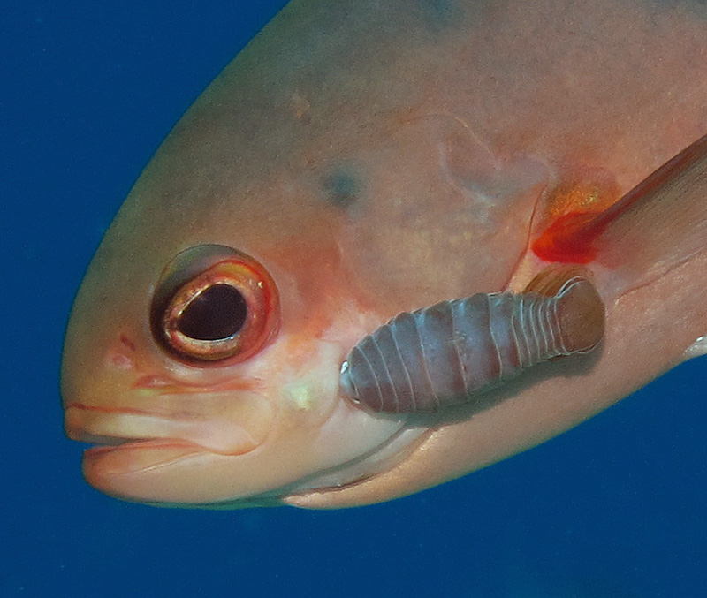
Ecology: Community Dynamics
Symbiosis: Parasitism

Slide 17
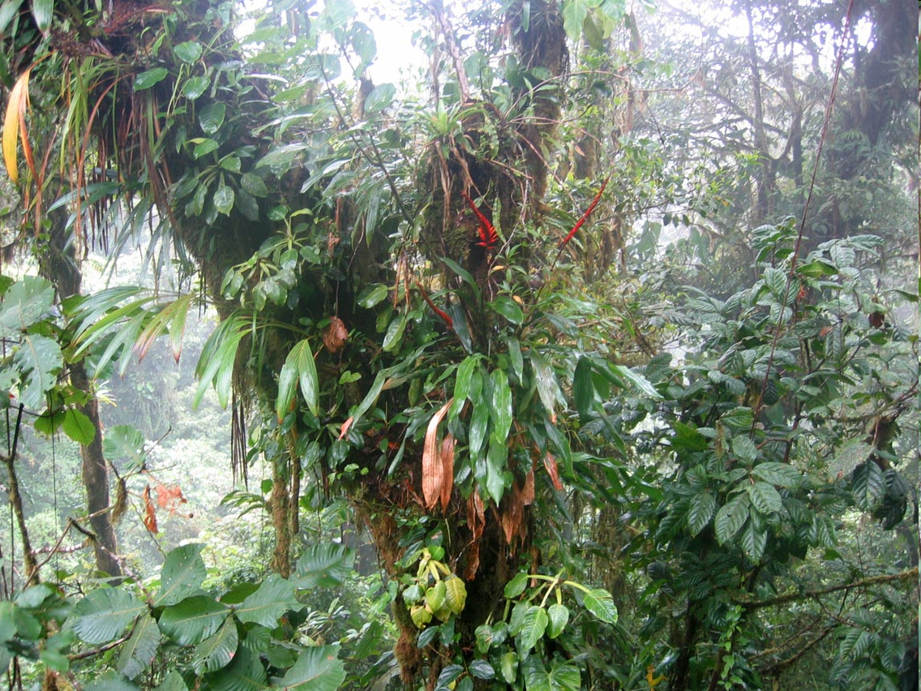
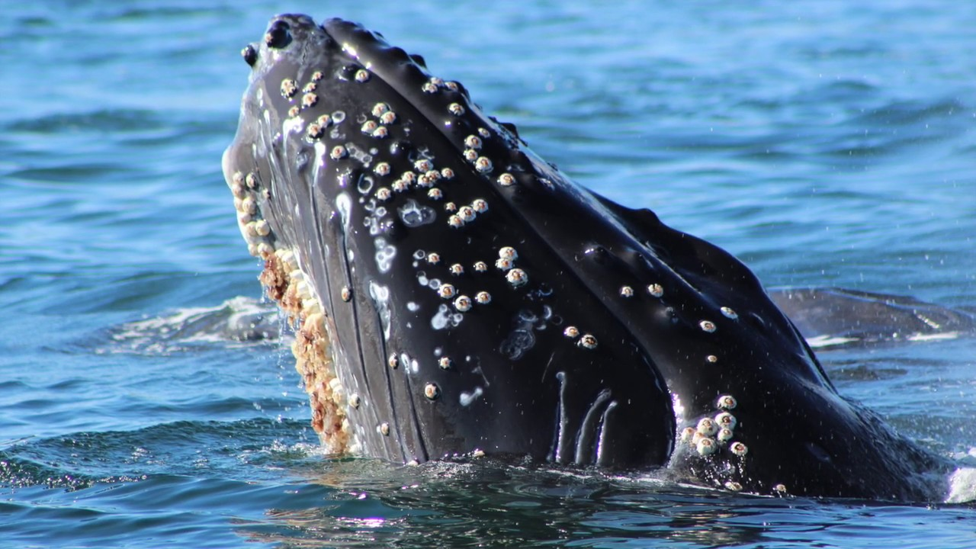
Ecology: Community Dynamics
Symbiosis: Commensalism

Slide 18
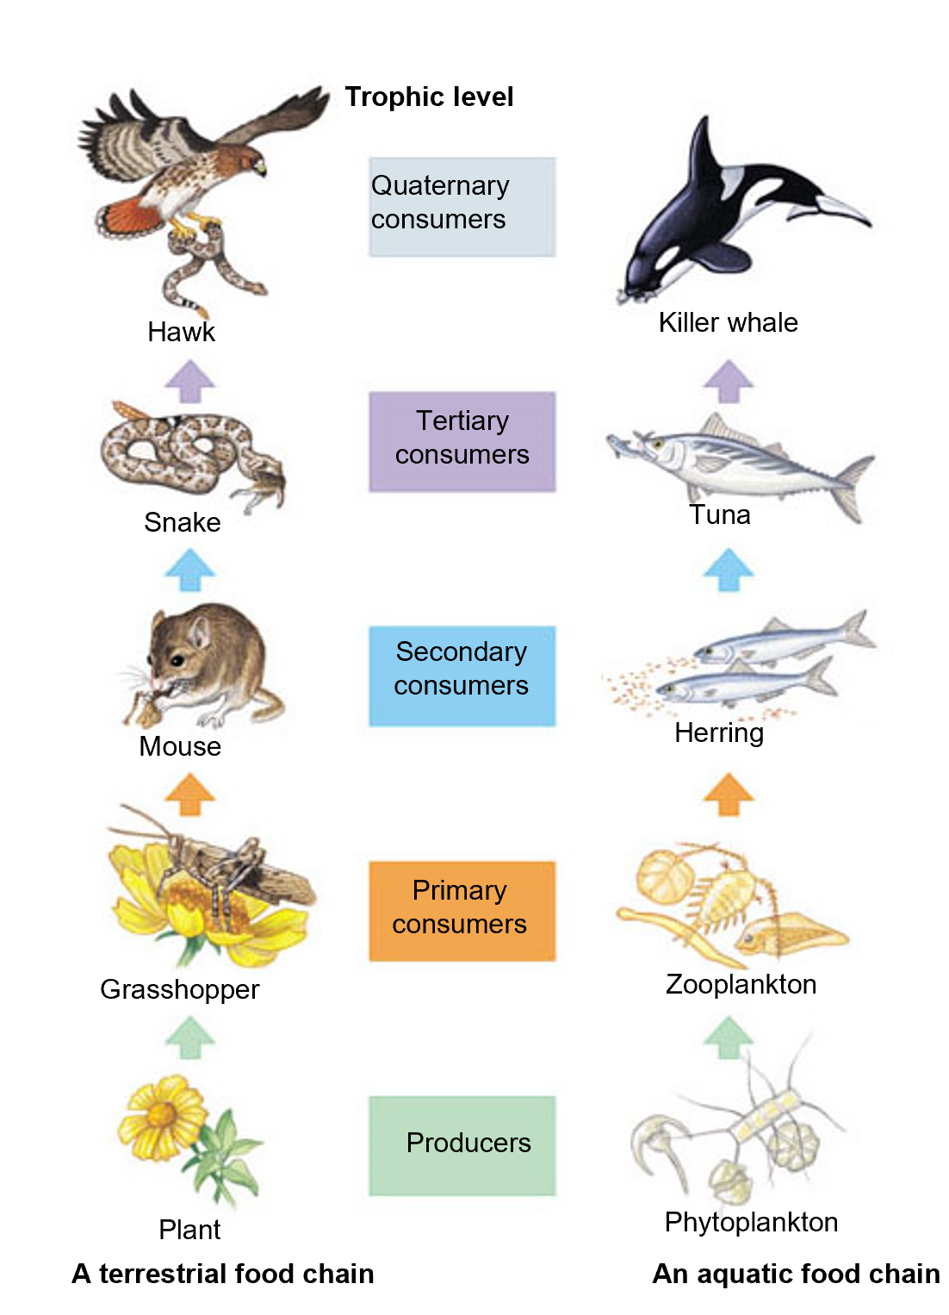
Ecology: Ecosystem Dynamics
Trophic structures can be represented by food chains
Decomposers: fungi and bacteria decompose waste matter and recycle nutrients in ecosystems

Slide 19
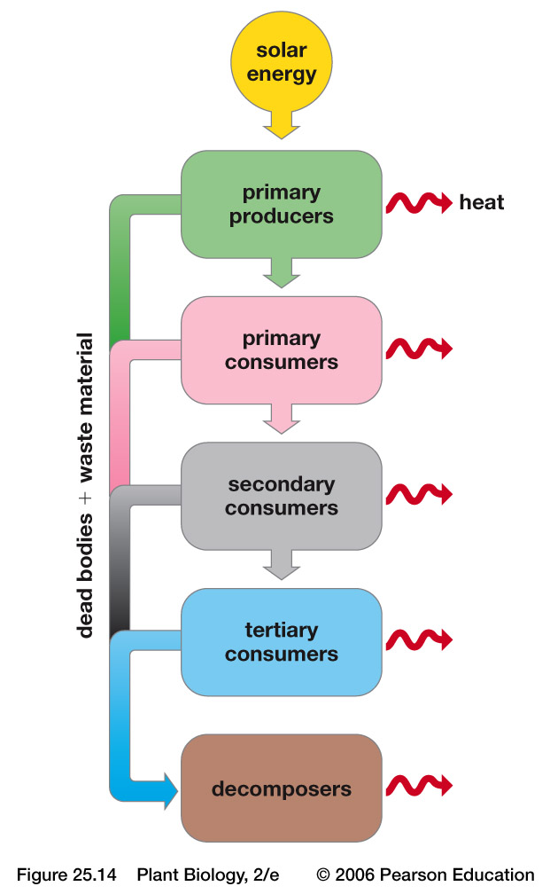
Ecology: Ecosystem Dynamics
Energy moves into an ecosystem in the form of sunlight captured by photosynthesizers and out in the form of heat.

Slide 20
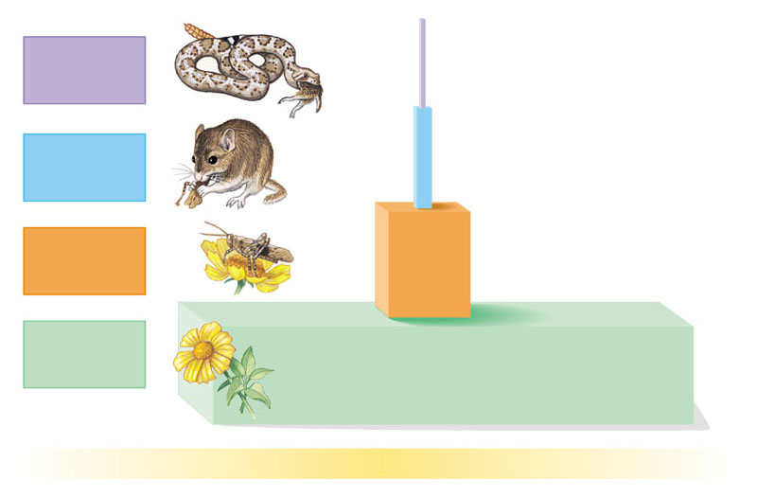
Ecology: Ecosystem Dynamics
0
Energy supply limits the length of food chains
A pyramid of production shows the flow of energy from producers to primary consumers and to higher trophic levels
Tertiary
consumers
10 kcal
100 kcal
Secondary consumers
Primary
consumers
1,000 kcal
Producers
10,000 kcal
1,000,000 kcal of sunlight

Slide 21
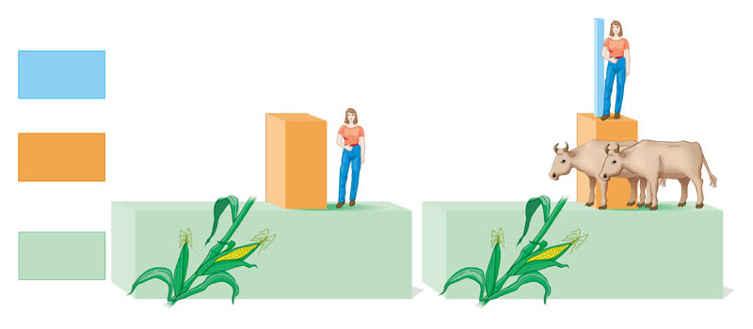
Ecology: Ecosystem Dynamics
0
A production pyramid explains why meat is a luxury for humans
A field of corn can support many more human vegetarians than meat-eaters
Trophic level
Secondary consumers
Human
meat-eaters
Cattle
Primary consumers
Human
vegetarians
Corn
Corn
Producers

Slide 22
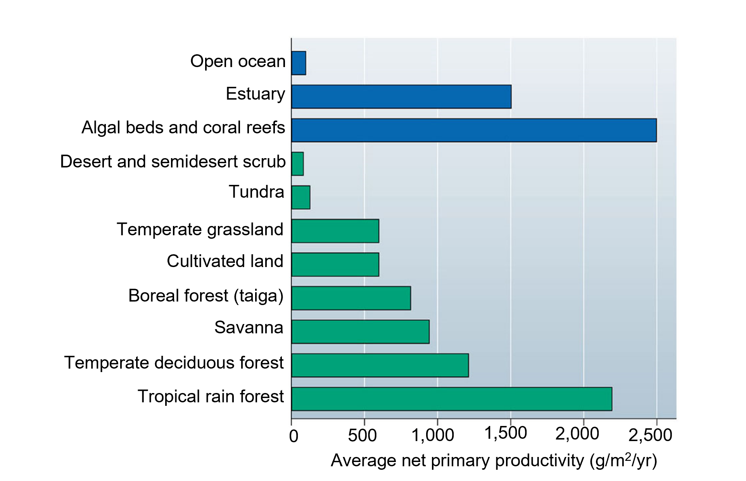
Ecology: Ecosystem Dynamics
Primary production sets the energy budget for ecosystems
Primary production is the rate at which producers convert sunlight to chemical energy in organic matter, or biomass

Slide 23
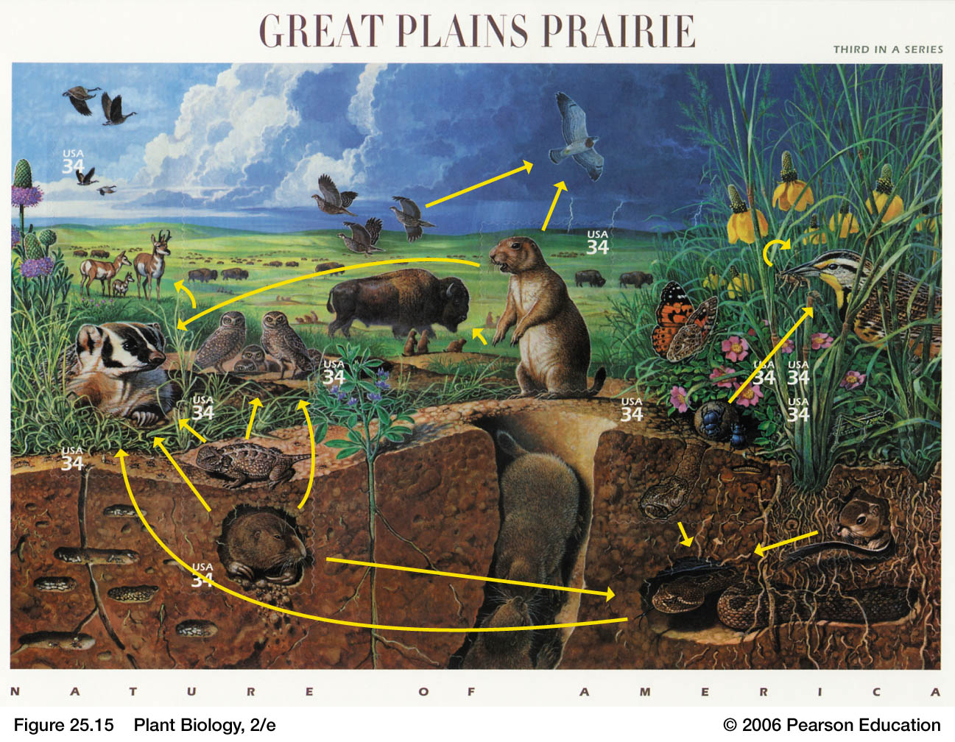
Ecology: Ecosystem Dynamics

Slide 24
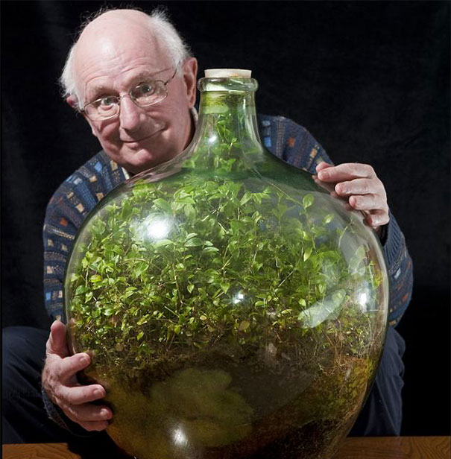
Ecology: Ecosystem Dynamics
David Latimer and his 60 year old terrarium.

Slide 25
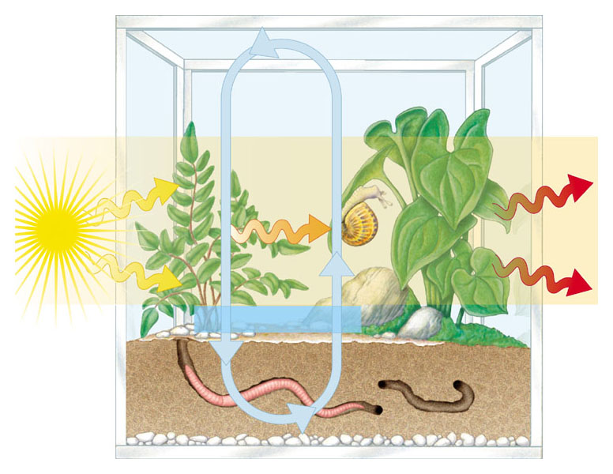
Ecology: Ecosystem Dynamics
0
Chemicals are recycled between organic matter and abiotic reservoirs
Chemical
cycling
Energy
flow
Chemical
energy
Light
energy
Heat
energy
Chemical elements
Wolves in Yellowstone

Slide 26
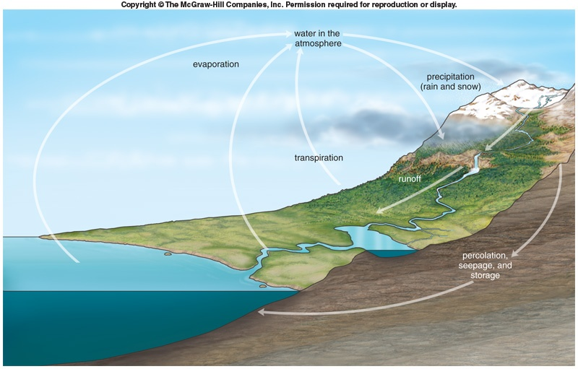
Ecology: Ecosystem Dynamics
The water cycle:

Slide 27
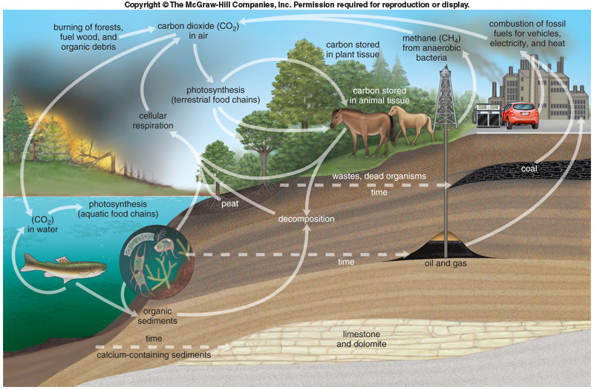
Ecology: Ecosystem Dynamics
The carbon cycle
Variables influencing climate change.

Slide 28
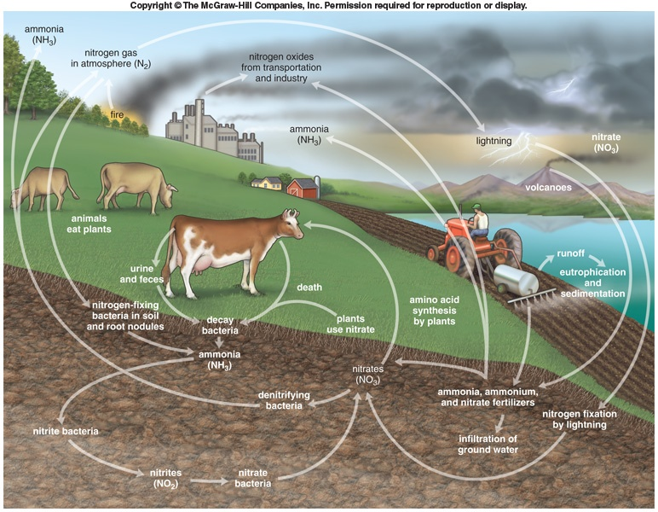
Ecology: Ecosystem Dynamics
The nitrogen cycle:

Slide 29
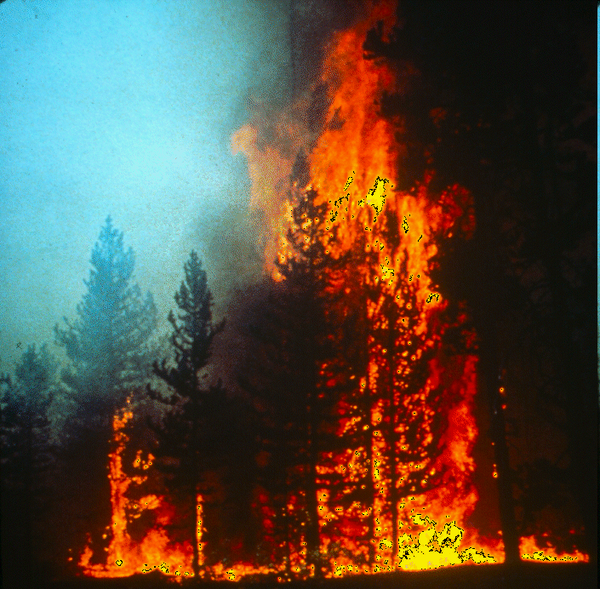
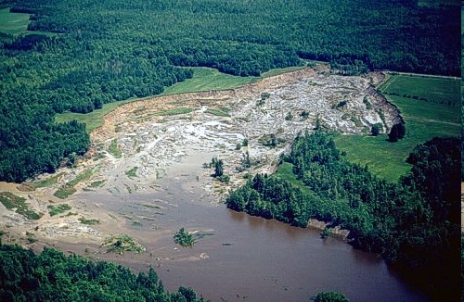
Ecology: Disturbance
0
Disturbance is a prominent feature of most communities
Disturbances are events that damage biological communities, remove organisms from them, and alter the availability of resources are characteristic of most communities

Slide 30
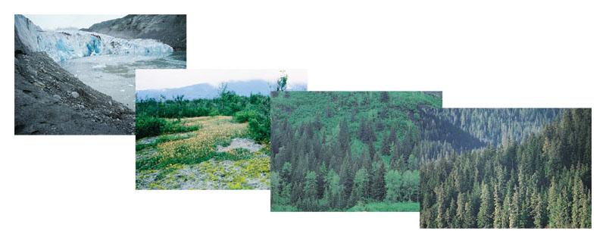
Ecology: Succession
0
Ecological succession
Is a transition in species composition of a community following a disturbance
Retreating glacier with moraine in the foreground
Dryas stage
Spruce starting to appear in the alder and cottonwood forest
Spruce and hemlock forest

Slide 31
Ecology: Succession
0
Primary succession
Is the gradual colonization of barren rocks
Secondary succession
Occurs after a disturbance has destroyed a community but left the soil intact

Slide 32
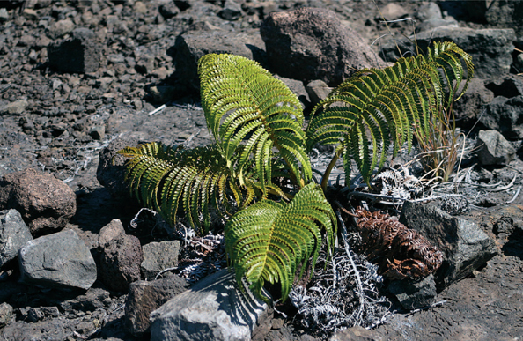
Ecology: Succession
Primary succession - Involves formation of soil in beginning stages
On bare rocks and lava:
Tiny cracks permit plants to invade.
Fern spores blow into cracks of bare lava

Slide 33
Ecology: Succession
Primary succession:
On bare rocks and lava:
Lichens and mosses become established on surfaces.
Contribute to organic matter and small amount of soil builds up
Other species become established.
As soil buildup continues, larger plants take over.
Eventually vegetation reaches equilibrium of a stable plant community = climax community.
Communities can differ in response to available species and chance events.

